Slide 1

FOA Automation tool
Earth and Environmental Sciences Area

Slide 2
Introduction
This project has been pulled together in collaboration with Web Development company HyperArts.
The vision is to create a single source site where our staff can have real-time access to an active database of funding opportunities. When using this tool, our staff can easily search, sort and filter to create a personalized list, tailored to their research area.
Users will be able to connect with one another to share and exchange ideas, manage and favorite their selected opportunities, and create their own personal dashboard where over time, the system will be able to generate “smart suggestions” based on their search history.
This site will be accessed under the protection of the user’s Lab login to ensure that all internal conversations remain internal and promote the concept of collaborating openly and assembling teams in a transparent and equitable fashion.

Slide 3
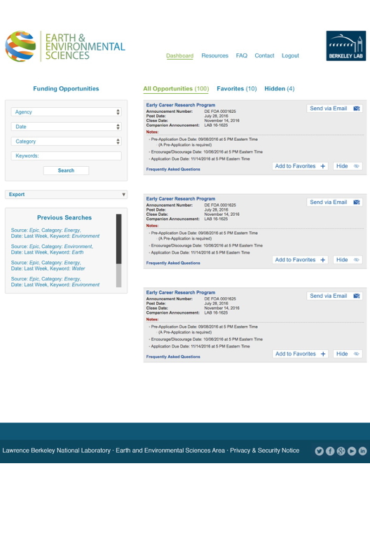
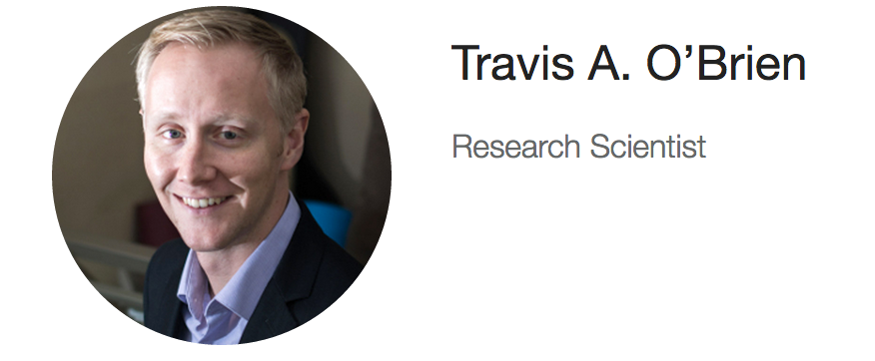

The user’s Dashboard
On a user’s main dashboard, they can easily toggle between tabs to search all opportunities or just items they have chosen as favorites.
The user has various ways they can search these opportunities to include: by agency, due date (range), research category, or simply by keyword (i.e geochemistry or climate change). For a very condensed and specific list, you may select multiple search criteria (i.e NASA & “Space Biology”).
Beneath the search widget, each user will also be able to access their previous search data as well as save their typical search criteria for easy “one-click” results.
Once you have one or more favorite’s added to your list, you may export this data as an .xml, tab delimited or .csv format to share with colleagues.
POC: William Collins
POC: Andrew Jones
POC: Jens Birkholzer

Slide 4
Collaborating with your peers
On each posting, you have the ability to choose several actions to start collaborating with your peers:
1. Click the “express interest button”. This makes your name visible to your colleagues so that you can connect.
2. Email a posting to your supervisor, peers or administrator for further exploration of the opportunity
3. Choose to “make a comment” if you are in the process of researching the opportunity, have an idea or advice as to how to approach the proposal or want to add valuable insight.
POC: Carl Steefel
POC: Travis O’Brien
POC: Peter Nico

Slide 5
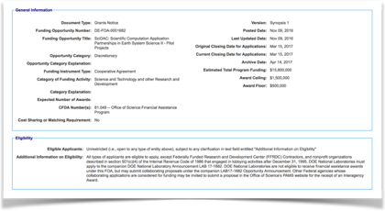
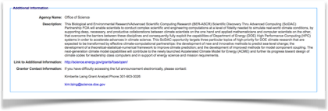
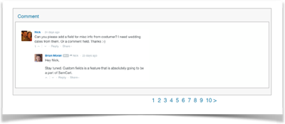
Show me more information
When you find an opportunity that you like, you simply click the title and more information is populated in a hover screen, so you never have to leave the page.
From here you can see all vital information about a posting as well read and contribute to the conversations started by your peers.
View
Comments
(4)

Slide 6
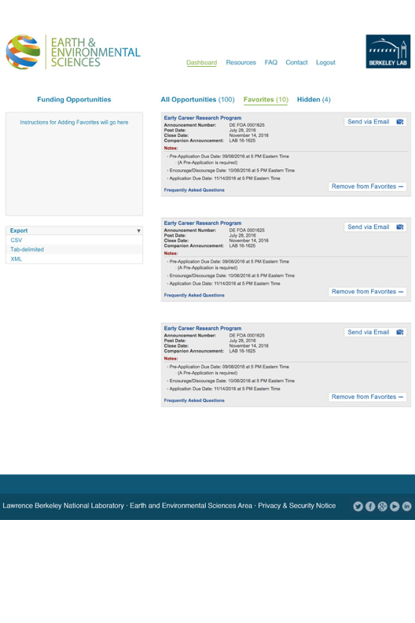
Favorites and smart suggestions
A user can toggle to their favorites list to only view their saved postings.
Overtime, the tool will start to recognize the user’s activity by tracking clicks. In the database there are keywords which are automatically assigned to a posting and as a user’s activity begins to form obvious trends, “suggested opportunities” will populate on the user’s dashboard.
The more active a user is, the more accurate these suggestions will become. This feature saves time and brings relevant opportunities to the user without having to search further.
POC: Curt Oldenburg
POC: Gary Anderson
POC: Eoin Brodie

Slide 7
Show me everything
Equally as important as being able to “favorite” opportunities, a user is able to unfavorite or “hide” posts from their search results for a cleaner and more customized list. Should a user choose to re-access previously hidden opportunities, they can toggle to the “Hidden” tab where they can go in and choose the postings they wish to restore.
To the left of the postings, step-by-step instructions will be displayed informing the user how to favorite, hide, unhide & view all to simplify the user experience.
POC: Curt Oldenburg
POC: Gary Anderson
POC: Eoin Brodie

Slide 8
Automatically Designate a Point of Contact
To ensure our community is informed who to contact directly to learn more about an opportunity, a point of contact will be automatically assigned to each posting. Logistics of how these determinations should be made have yet to be decided but there are several options:
1. Program Domain Leads and Program Leads, assigned by DOE Program Manager for Office of Science Postings or by Keyword associations in FOA title for non-federal or postings by other agencies
2. Program Domain Leads and Program Leads, assigned based on funding agency and keyword (two criteria).
3. Program Domain Leads and Program Leads assigned by category (i.e. Category: Nuclear Energy = assigned to Jens Birkholzer)
Admittedly this may not be a perfect science and the occasional posting may be incorrectly assigned. As a solution to this challenge, users are able to reassign postings to colleagues or remove their name as the POC.
Program Domain Leads and Program Leads will receive an email once-a-week with the opportunities they have been assigned to. At this point they can choose whether to keep or remove their name on the posting.
POC: William Collins
POC: Andrew Jones
POC: Jens Birkholzer

Slide 9
The inside scoop
For opportunities that are not formally posted on any website, this tool allows users to manually inform the broader community.
To do this, a user clicks “Post to Site” from their dashboard and are brought to a form where they can input this notification. To ensure consistency, there will be mandatory fields that must be filled in before they are able to submit.
These opportunities which have been manually posted to the site will be flagged as “Coming Soon” by default.

Slide 10
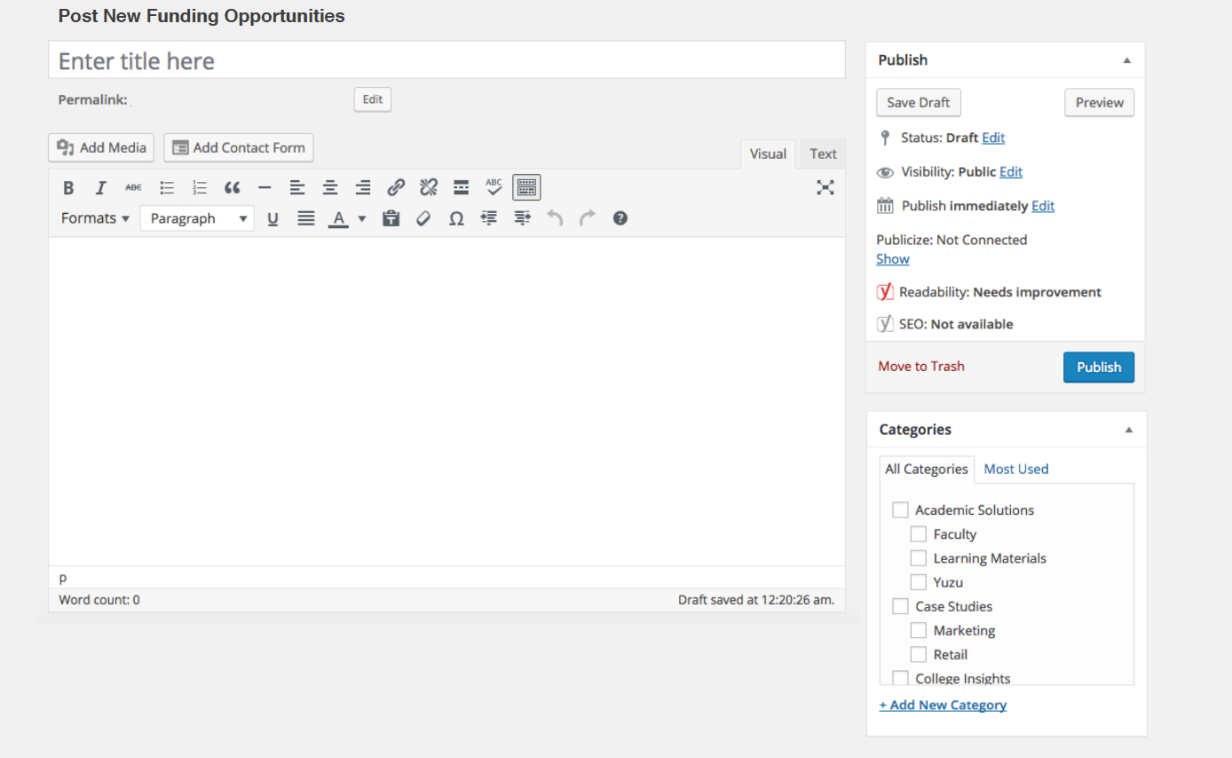

The inside scoop
For opportunities that are not formally posted on any website, this tool also allows users to manually post.
To do this, a user clicks “Post to Site” from their dashboard and are brought to a form where they can input the information. To ensure consistency, there will be mandatory fields that must be filled in before they are able to submit.
If a user knows this posting is likely to be made public to an agency website in the future, they will have an option of clicking a button titled “Coming Soon”, which flag the posting so the broader community understands this has not been formally announced.
Minimum of 250 words

Slide 11
Thank you.
Earth and Environmental Sciences Area

